Slide 1
File Handling
Life Choices Coding Academy 2020

Slide 2
Learning outcome:
By the end of this section, student should be able to:
Manipulate files using Python File IO functions.
Process data from other programs

Slide 3
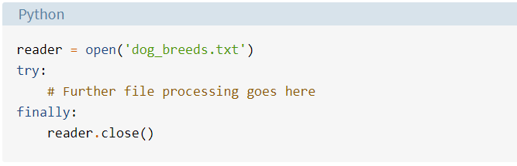
File Handling
We can manipulate the file using open() and close() functions.
If you need to open a file in Python, use the open() method.
When you’re done with the file, be sure to close() so that we release that memory.
Example:
Notes:
A file is some information or data which stays in the computer storage devices.
Generally we divide files into two categories, text file and binary file. Text files are simple text where as the binary files contain binary data which is only readable by computer.
It’s important to remember that it’s your responsibility to close the file. In most cases, upon termination of an application or script, a file will be closed eventually. However, there is no guarantee when exactly that will happen.
Also demo what happens if document is not available in the directory.

Slide 4
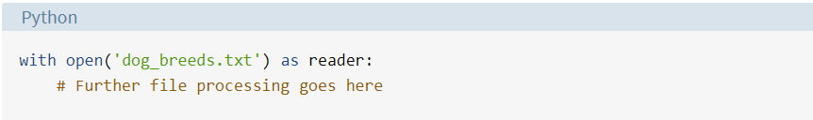
With statement
The second way to close a file is to use the with statement:
vff
Notes:
The with statement automatically takes care of closing the file once it leaves the with block, even in cases of errors.

Slide 5
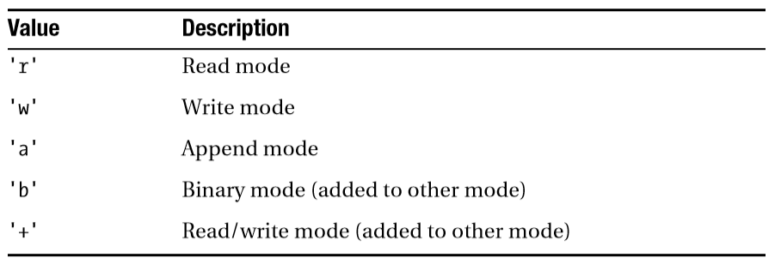
The Mode Argument
Most likely, you also want to use the mode argument.
This argument is a string that contains multiple characters representing how you want to open the file.
More available online.
Notes:
If you want to write to the file, you have to state that explicitly, supplying a mode argument. Let's briefly discuss a few and when will you use them.
Note: Python doesn’t depend on the underlying operating system’s notion of text files; all the processing is done by Python itself, and therefore platform-independent.
https://docs.python.org/3/library/functions.html#open

Slide 6
But how do we read the data from the file?

Slide 7
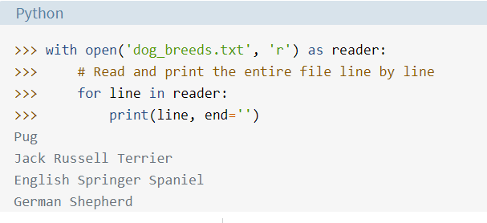
For loop to the rescue!
The end=’’ is to prevent Python from adding an additional newline.
Notes:
Make sure you have the required file on the path.
Demonstrate that even a while loop can be used.

Slide 8
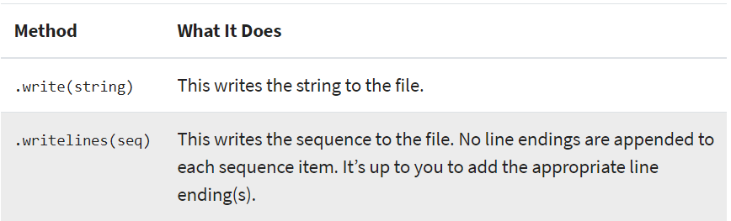
Writing into files.
Now let’s dive into writing files. As with reading files, the objects have multiple methods that are useful for writing to a file:
Notes:
Explore the documentation for more information.

Slide 9
Thanks

Slide 10
In-class Exercise
Write a Python program to find the longest word in the The Zen of Python?
Write a Python program to count the number of lines in "The Zen of Python?
Notes:
The word should be?
The count should be?

